Slide 1
Agricultural extension as experienced
Relations with family, neighbours, and the pesticide vendor
Dr. Brian Cook
The School of Geography, Earth and Atmospheric Science
The Faculty of Science
The University of Melbourne

Slide 2
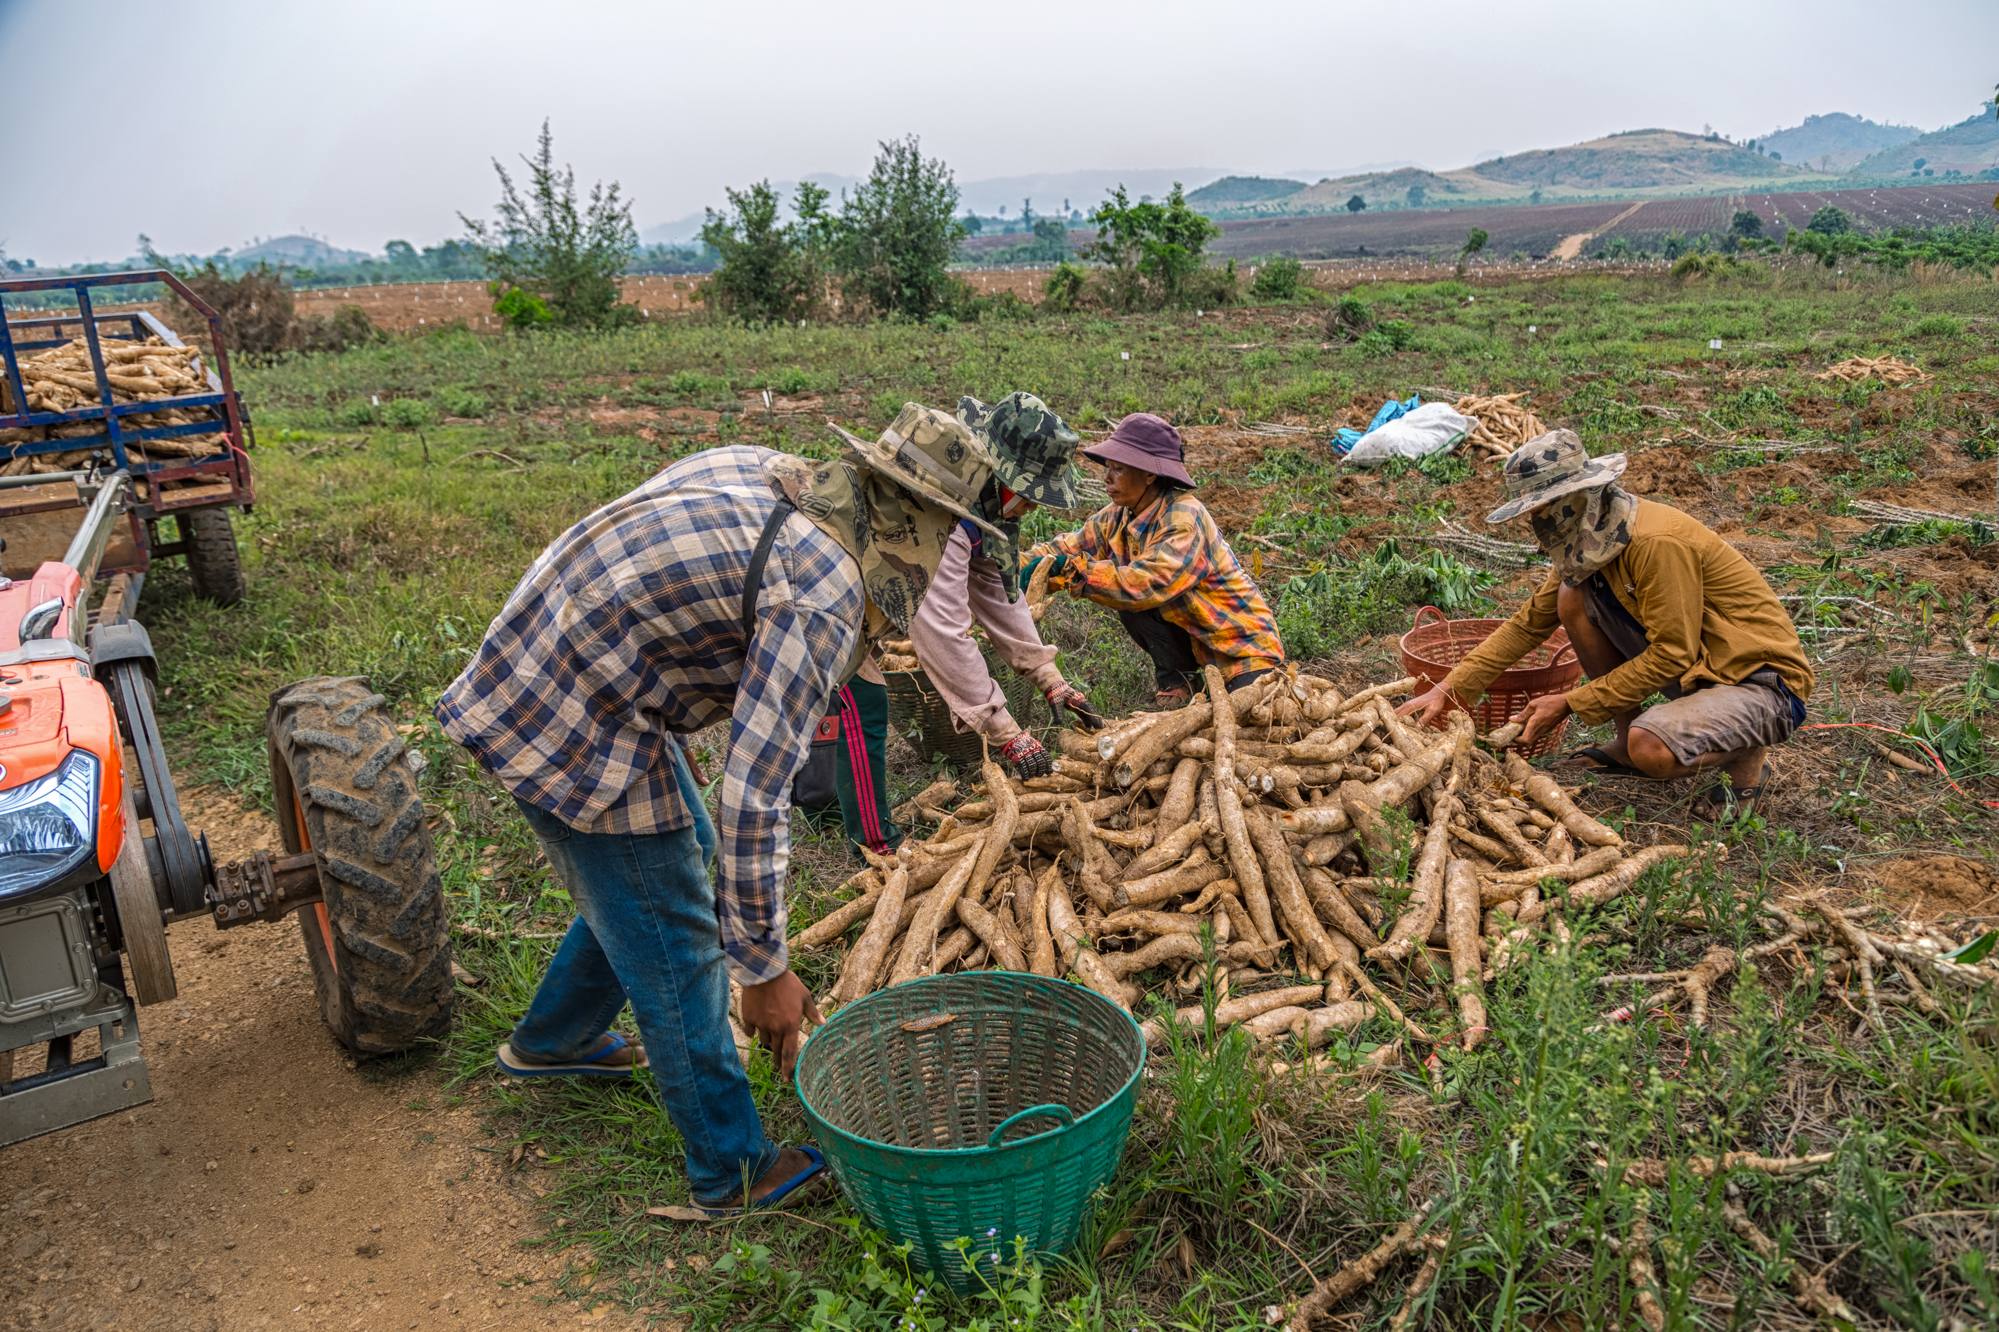
Outline
Introduction
Outline (here)
Methodology
Findings
Argument
Conclusion
Possible Points for discussion

Slide 3
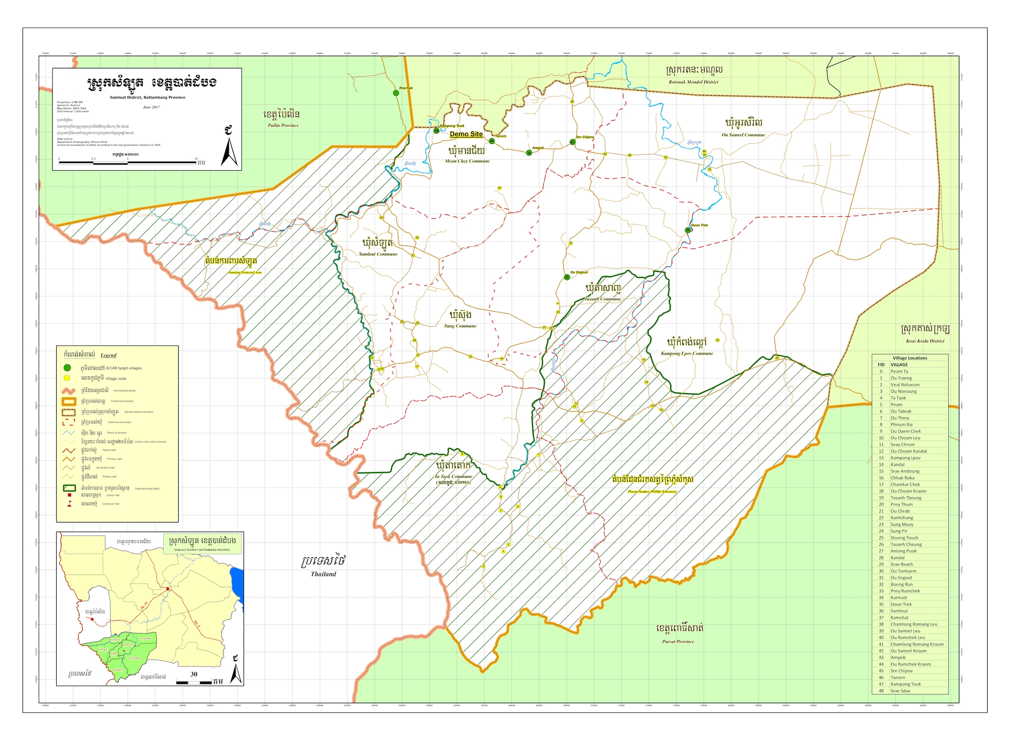
Methodology
Data collection
400 household surveys
300 household interviews
13 interviews with village leaders
Intensive knowledge exchanges
Repeat follow-up engagements with participants
Two demonstration farms testing cassava growing practices.
Theory of change
From Deficit-to-Practice
Critique of communications (in simple/one-way forms)
Cook, B., & Overpeck, J. (2019). Relationship-building between climate scientists and publics as an alternative to information transfer. Wiley Interdisciplinary Reviews: Climate Change, 10(2)
Cook, B. R., Satizábal, P., & Curnow, J. (2021). Humanising agricultural extension: A review. World Development, 140, 105337.

Slide 4
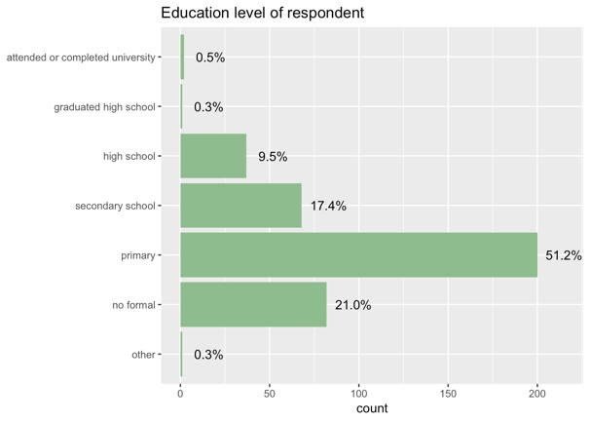
Quantitative Background and Findings

Slide 5
Qualitative Findings: Why did farmers transition to cassava?
“I: At first, I planted rice. Then after rice, I planted sesame. Then I planted mung bean as everyone was planting mung bean. Then I planted corn because everyone was planting corn. I started planting cassava because all of my neighbours were planting it.
F: So will you stop planting cassava when your fruit trees grow big?
I: Yes.
F: What made you change from cassava to fruit tree?
I: I’m following the other farmers. I’m planting mangos.”
“I: Farmers followed each other. So when one planted, another one started to follow.”
“I: I used to plant sesame but when I saw other farmers doing cassava, I followed them.
F: Why did you follow them?
I: I saw they received very good yield in the first year so I wanted to try also. Our soil nutrition is depleting so I cannot plant every year on the same soil.”
“I: Here we just followed each other. When we saw one planted, others started to follow no matter if it was corn or cassava.”
Analysis: Neighbours are ~95% of the social relations shaping their practices.

Slide 6
Qualitative Findings: How do farmers inform themselves?
“I: My father planted cassava and got a good yield. So I planted cassava also.”
“I: I saw other farmers planted cassava. I wanted to change from corn so I asked for planting materials from them and started planting cassava as well.”
“I: I followed my mother. Besides, cassava is lower maintenance and cost less than corn. Also, it’s easier to find labour for cassava than corn.”
F: What reason will make you stop planting cassava?
I: It’s because the price drops cheap.
F: What will you plant instead of cassava?
I: I will see what the rich farmers do. I will plant whatever they plant.
Analysis: Family and (already) trusted relations are how farmers assess the effectiveness of information or awareness of a new practice.
Throughout the 700+ engagements, these relations create an ability for farmers to vicariously experience alternate practices, which is their way of informing their decision making.
These ‘lessons’ that affect behaviour are practice based and experiential, suggesting a key distinction between practice and information transfer.

Slide 7
Qualitative Findings: Where do farmers get official information or advice?
“F: Did you ask anyone regarding to your problems facing growing cassava?
I: I asked my neighbours and they said nothing can help.
F: Why did you ask them?
I: No one care about us including the village chief. We have to rely on fellow farmers to help each other.
F: Were there anyone else coming to raise awareness on cassava?
I: No there weren’t.
F: What made you start planting cassava?
I: I saw other farmers in the village planted cassava and received good yield. So I started planting cassava as well.
F: What reason that made you stop planting cassava?
I: When my fruit trees grow big and there are no more spaces for cassava.
F: Which fruit trees do you have?
I: Rambutan and longan.”
“I: I didn’t ask anyone because everyone had the same problem.”
“I: I saw other farmers sprayed pesticide but not effective. So I didn’t do anything. Then the farmer whose farm got infected with red mite tried cutting the leaves and then the red mites were gone.
F: Were there anyone from PDA [Pailin Department of Agriculture] coming to raise awareness on cassava?
I: No there weren’t.”
Analysis: They don’t. See neighbours.
Farmers are disconnected from what we understand to be extension services and communications, which means that many official and expert efforts to support them are disconnected from how they inform themselves.

Slide 8
Qualitative Findings: What do farmers make of the pesticide vender?
“I: I’ve only asked my neighbours what to spray. Sometimes it worked, sometimes it didn’t.
F: Did you ever ask the pesticide seller?
I: Yes I did. Sometimes it worked on the first time. And when I used for the second time, it didn’t work.
F: Did you trust the pesticide seller?
I: Yes sometimes. Because I didn’t know anything, so I think the pesticide sellers knows more than me. And the pesticide also helped a little bit about 20 out of 50. When the rain came, the cassava became good again.”
“I: I only asked the pesticide seller because there’s no one to ask. They then would give me pesticide to spray but it’s not really working.
F: Did you trust the pesticide seller?
I: Not really. Some didn’t have good knowledge about it.”
“I: I asked the pesticide seller but it’s not effective.
F: Why didn’t you ask the specialist from agriculture department?
I: I don’t know where and who to ask.
F: So do you trust the pesticide seller?
I: Sometimes. The pesticide they gave me for other crops worked but the one on cassava didn’t.”
“I: No I didn’t. I didn’t know who to ask. I just went to buy pesticide from the pesticide seller.
F: Why did you think the pesticide seller can help you?
I: Because I didn’t know where I can get help besides going to buy pesticide from the pesticide seller.
F: Did you trust the pesticide seller?
I: At first I did. That’s why I went to buy pesticide but since the pesticide didn’t work, I lost trust in them.
F: Now you didn’t buy pesticide anymore?
I: No I didn’t. I only sprayed booster now.”
Analysis: The pesticide vender is the only member of the ‘formal’ agricultural sector who the farmers relate with. They rely on these individuals, but they are doubtful and suspicious because of past experiences and the experiences of others (i.e., through the social networks described previously).
Farmers are aware of the profit motivation of official extension activities, and therefore revert to their neighbours and trusted social relations to assess any new information or practices.
Farmers are risk averse and advance a ‘least cost input’ model, which means they are often seeking reasons to not invest.

Slide 9
Qualitative Findings: Constraints on adoption: debt
“I: It’s difficult. If I plant mango, I won’t have any income to support my family.
F: You’re losing every year.
I: Yes I’m always losing. But I don’t know what else I can do.
F: So you were saying you won’t have any money if you stop planting cassava? Is it true?
I: Yes. I will use some money to spend in the family and some to pay back loan. And then when there’s new crop cycle, I will take another loan to do it.”
“What is your happy or sad moment?
I: I’m earning just enough to live by. If the soil is good and there is enough rain, I can earn more for the family. Otherwise, I will lose my investment.
F: What will happen if your cassava failed?
I: It will be struggling for the family. Every family has debt to pay so if the farm fails, we are all doomed.”
“What is your happy or sad moment?
I: It’s hardworking being a farmer. We planted crop base on the rainfall. So sometimes we lose, sometimes we gain. But since we took loan to do the farm, it’s putting pressure on the family financial. We have obligation to pay back the loan, so if the crop fails, it will highly impact my family. I need to sacrify my food and sometimes we pay back late because of money.”
Analysis: ~95% of farmers had used micro-credit loans in the last year, with many relying on ’debt juggling’ to transition from one loan to another.
Every agricultural decision, therefore, is interpreted through the lens of debt and the threat of default.
How did cassava help your family?
I: It helped a little bit for my family just to get by. If I don’t do farming, who will lend me their money?

Slide 10
Qualitative Findings: the reality of farmers’ experiences
“F: As a farmer yourself, can you show/tell other people what is it like being a cassava farmer? What has cassava helped your family so far?
I: It hasn’t helped me with anything big. It’s barely enough to start a new farming cycle. I have to borrow money to do it.
F: How about your daily food?
I: I’m earning extra income from doing wedding program planning. I cannot rely totally on farming. The income from the farm is hardly cover its cost.”
“I: It’s just enough for me to pay debt and leaves some money for living expenses. I don’t have any big savings. The farming cost is high so it doesn’t leave much profit for me. That’s why I’m changing to mango as it provides a more sustainable income.
F: Have you bought any assets with cassava’s money yet?
I: No. Not yet. The labour cost is high and I’ve spent so much on the farm. I don’t know what to plant to earn good income now. I think if I keep planting corn and cassava, I won’t release myself from debt. The more I plant, the more debt I have. My children invested more than USD1,000 in a cucumber farm. When s/he harvested, the price was only 200 riels per kg. Now s/he ran away to pick garbage in Phnom Penh.”
Analysis: the farmers describe ‘no win’ situations in which they are expected to invest in pathways that are very unlikely to justify the returns. Similarly, there is no alternative, with the consequences of failure
Analysis: there is a hopelessness evident throughout the findings that is difficult to put into words. The farmers know that these are life/death decisions that will affect their children and others.
dire.
F: Did you ask anyone regarding to your problems facing growing cassava?
I: I asked my neighbours and they said nothing can help.
F: Why did you ask them?
I: No one care about us including the village chief. We have to rely on fellow farmers to help each other.
F: Were there anyone else coming to raise awareness on cassava?
I: No there weren’t.
F: What made you start planting cassava?
I: I saw other farmers in the village planted cassava and received good yield. So I started planting cassava as well.
F: What reason that made you stop planting cassava?
I: When my fruit trees grow big and there are no more spaces for cassava.
F: Which fruit trees do you have?
I: Rambutan and longan.

Slide 11
Conclusion
Farmers are disconnected from formal extension and rely on social relations to inform their practices.
Any action taken is debt-fueled and costly, making change an extremely difficult and complex choice.
They do not lack information, but trustworthy support.
What factors drive behavioural changes amongst Cambodian cassava farmers?
Their neighbours, family members, trusted social relations.

Slide 12
Conclusion
The connective ‘tissue’...
Neighbours are the primary mode of transfer;
Practices and experiences (of family) constrain decisions;
There is no connection with formal extension sector;
The pesticide vendor has poisoned relations;
Debt is high and consequences of default extreme;
Farmers feel isolated and trapped and without viable options.
Is there a model of extension that works in this context?
What is the underlying theory of change that would work in this context?
Thank You

Slide 15
Possible points for discussion (in no particular order)
What is the future of agricultural extension if/when...
Friends, family members, neighbours, and social networks/relations
Is there a form of ‘informal extension’ that external partners can become a part of? Should they?
Pesticide vendors as the only contact of formal extension.
The private sector is prioritized, but what about when there is no trust. Is a profit-driven model possible?
Isolated farmers – what is extension if there is no safety net?
Risk Aversion and Low-input/cost/risk farming models have long been understood, but what might this framing entail for extension practices?
Theory of change for agricultural extension based on practices and experiential learning.

